Slide 1
BIGMART SALES PROJECT ON EXCEL
THIS COMPLETE PROJECT IS ABOUT THE SALES OF THE COMPANY NAME AS BIGMART AND USING THE DATA, CAME UP WITH THE VALUEABLE INSIGHTS IN A DASHBOARD
THIS COMPLETE DATA SET HAS 11 COLUMNS AND TOTAL 8524 ROWS
AND THE FIELDS OR TERMS WHICH THIS DATASET HAS ARE AS FOLLOWS:
ITEM IDENTIFIER, ITEM WEIGHT, ITEM FAT CONTENT, ITEM TYPE, ITEM MRP, OUTLET IDENTIFIER, OUTLET ESTABLISHMENT YEAR, OUTLET SIZE, OUTLET LOCATION TYPE, OUTLET TYPE, ITEM OUTLET SALES

Slide 2
QUESTION BASED ON THE DATASET
WHAT IS THE HIGHEST AND LOWEST SALES IN PARTICULAR YEAR?
WHICH ITEM TYPE HAS THE HIGHEST AND LOWEST SALES?
WHAT IS THE MAXIMUM AND MINIMUM ITEM WEIGHT OF A ITEM TYPE?
WHICH TYPE OF OUTLET HAS THE HIGHEST AND LOWEST SALES?
WHAT IS THE TOTAL ITEM MRP WITH RESPECT TO ITEM TYPE?
WHAT IS THE TOTAL COUNT OF FAT CONTENT?
IN WHICH YEAR THE SALES WERE HIGH AND LOW?
WHICH ITEM TYPE HAS THE HIGHEST SALES IN AN OUTLET ESTABLISHMENT YEAR?
WHAT IS THE SALES OF THE OUTLET TYPE ACORDING TO THE OUTLET SIZE?
WHAT IS TOTAL COUNT OF OUTLET TYPE?
WHAT IS THE TOTAL SALES OF PARTICULAR LOCATION

Slide 3
WHAT IS THE HIGHEST AND LOWEST SALES IN PARTICULAR YEAR?
HIGHEST SALE - 3633637 IN 1985
LOWEST SALE - 188338 IN 1998

Slide 4
The highest sales of fruits and vegetables were 2820050 and the lowest of sea food was 148870.
WHICH ITEM TYPE HAS THE HIGHEST AND LOWEST SALES?

Slide 5
WHAT IS THE MAXIMUM AND MINIMUM ITEM WEIGHT OF A ITEM TYPE?
MAXIMUM WEIGHT - 13536
MINIMUM WEGHT - 638

Slide 6
WHICH TYPE OF OUTLET HAS THE HIGHEST AND LOWEST SALES?
HIGHEST SALES BY OUTLET TYPE IS SUPER MARKET 1
LOWEST SALES BY OUTLET TYPE IS GROCERY STORE

Slide 7
WHAT IS THE TOTAL ITEM MRP WITH RESPECT TO ITEM TYPE?
TOTAL MRP OF ITEM IS 1201650

Slide 8
WHAT IS THE TOTAL COUNT OF FAT CONTENT?
LOW FAT – 5517
REGULAR - 2889
REG - 117

Slide 9
IN WHICH YEAR THE SALES WERE HIGH AND LOW?
HIGHEST SALE IN 1985
LOWEST SALE IN 1998

Slide 10
WHICH ITEM TYPE HAS THE HIGHEST SALES IN AN OUTLET ESTABLISHMENT YEAR?
HIGHEST - 1463

Slide 11
WHAT IS THE SALES OF THE OUTLET TYPE ACORDING TO THE OUTLET SIZE?
SUPERMARKET TYPE 1 - 1512239
SUPERMARKET TYPE 3 - 442796
SUPERMARKET TYPE 2 - 195710
GROCERY STORE - 39896

Slide 12
WHAT IS TOTAL COUNT OF OUTLET TYPE?
SUPERMARKET TYPE 1 - 5577
SUPERMARKET TYPE 3 - 935
GROCERY STORE – 1083
SUPERMARKET TYPE 2 - 928

Slide 13
WHAT IS THE TOTAL SALES OF PARTICULAR LOCATION
TIER 3 - 7636777
TIER 2 - 6472316
TIER 1 - 4482069

Slide 14
CONCLUSION
FROM THE DATA SET, IT IS CONFIRM THAT, YEAR 1985 HAS HIGHEST SALES AND 1998 HAS LOWEST SALES
ALSO FRUITS AND VEGETABLES HAVE THE HIGHEST SALES AND SEAFOOD HAS THE LOWEST SALES
THE MAXIMUM WEIGHT OF THE ITEM TYPE IS 13536 AND THE MINIMUM WEIGHT IS 638
ALSO, SUPERMARKET 1 HAS THE HIGHEST SALES AND GROCERY STORE HAS THE LOWEST SALES
THE TOTAL ITEM MRP IS 1201650
TOTAL COUNT OF LOW FAT IS 5517, REGULAR IS 2889, AND REG IS 117
IN YEAR 1985 THE SALES WERE HIGH, AND IN YEAR 1998 THE SALES WERE LOW
THE HIGHEST COUNT OF THE ITEM SALE IS 1469 IN YEAR 1985
THE SUPERMARKET TYPE 1 HAS 12917358 SALES IN ALL OUTLET SIZES
SUPERMARKET TYPE 1 HAS HIGHEST COUNT AND SUPERMAKET TYPE 2 HAS LOWEST COUNT AS 5577 AND 928
TIER 3 HAS HIGHEST SALES AND TIER 1 HAS LOWEST SALES

Slide 15
INTERACTIVE DASHBOARD

Slide 16
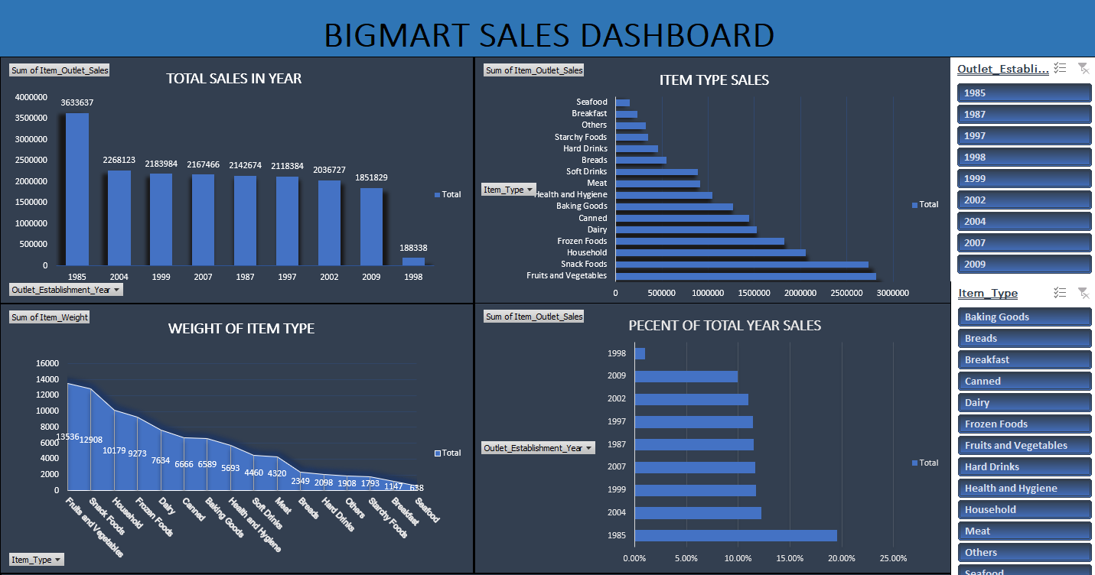

Slide 17
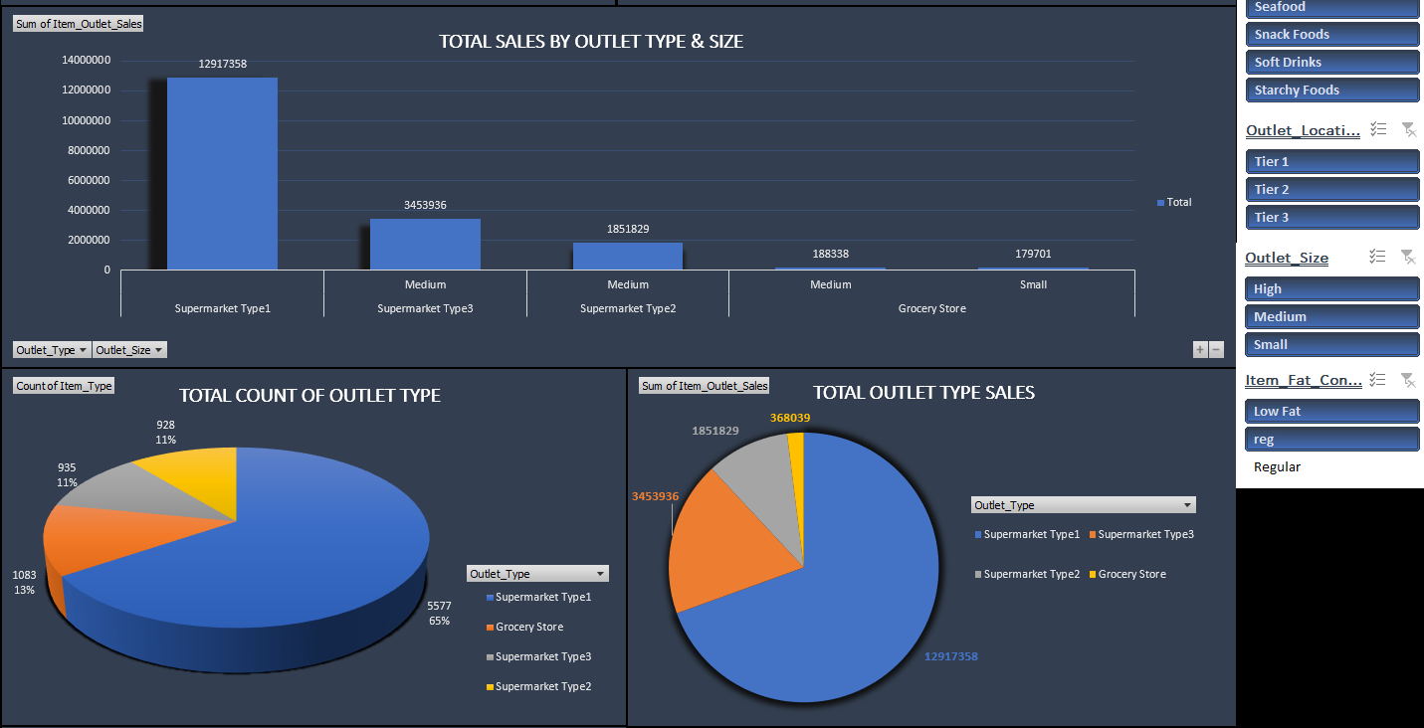

Slide 18
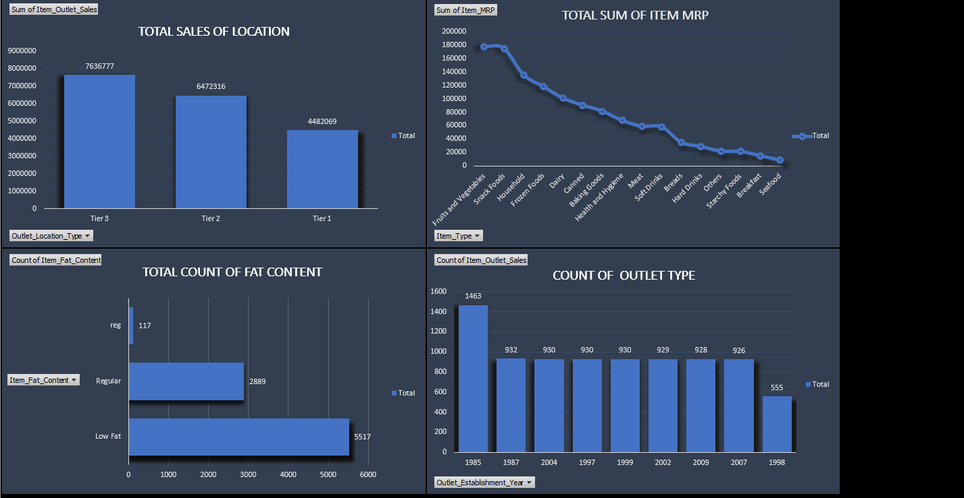

Slide 19
THANK YOU

